Slide 1








KARAMOJA FOOD SECURITY
BY GROUP 2

Slide 2
BACKGROUND
Karamoja is the most food-insecure region of Uganda. One of the main reasons is the low productivity level of crops due to intense droughts, as well as outbreaks of pests and diseases.
We have conducted an analysis of the 2017 crop yield to identify ways in which the region could be better supported in terms of resource distribution.

Slide 3
PROJECT GOAL
Understanding the areas that have the lowest yields, to have them prioritized in terms of resource distribution

Slide 4
OBJECTIVES
Identify regions with the lowest total yield
Identify regions with the lowest sorghum yield per HA
Identify regions with the lowest maize yield per HA
Correlation between population size and yield
Correlation between crop area and yield

Slide 5
REGIONS WITH LOWEST YIELD OVERALLY
DISTRICTS
MOROTO
ABIM
AMUDAT
NAPAK
SUB COUNTIES
SOUTHERN DIVISION
NORTHERN DIVISION
AMUDAT TOWN COUNCIL
NAKAPIRIPIRIT TOWN COUNCIL
KAABONG TOWN COUNCIL
KATIKEKILE
LODIKO
KAABONG EAST
NGOLERIET
TAPAC

Slide 6
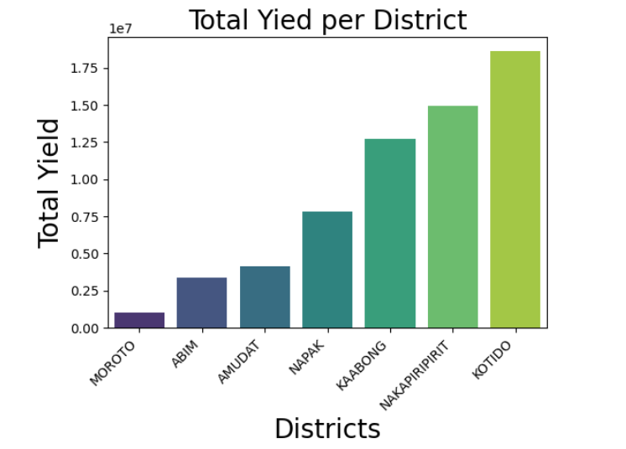

Slide 7
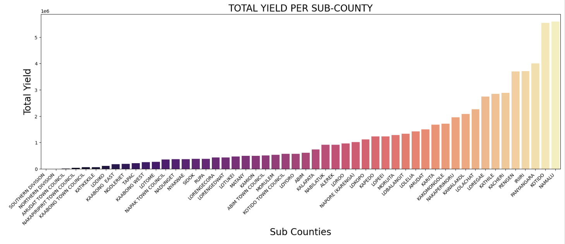

Slide 8
REGIONS WITH THE LOWEST SORGHUM YIELD
DISTRICTS
MOROTO
NAPAK
AMUDAT
KAABONG
SUB COUNTIES
LOPEEI
RUPA
SOUTHERN DIVISION
LOKOPO
LOTOME
MATANY
NORTHERN DIVISION
NADUNGET
NGOLERIET
AMUDAT TOWN COUNCIL

Slide 9
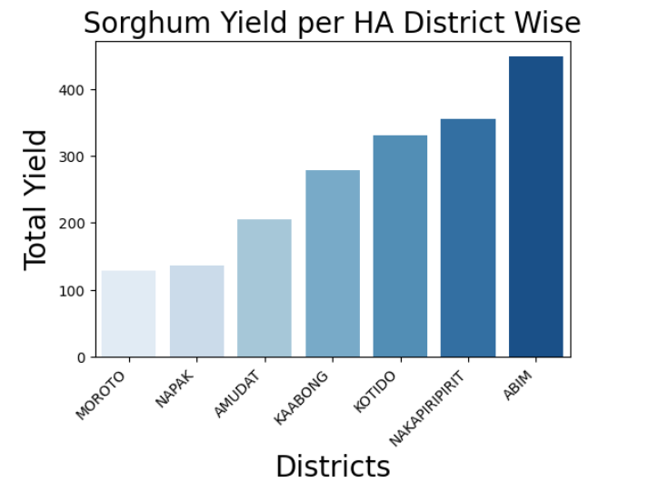

Slide 10
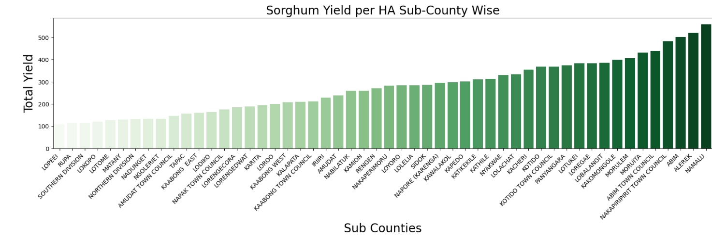

Slide 11
REGIONS WITH THE LOWEST MAIZE YIELD
DISTRICTS
MOROTO
NAPAK
KAABONG
ABIM
SUB COUNTIES
SOUTHERN DIVISION
TAPAC
NORTHERN DIVISION
MATANY
LOTOME
NGOLERIET
KATIKEKILE
NADUNGET
KALAPATA
KAABONG EAST

Slide 12
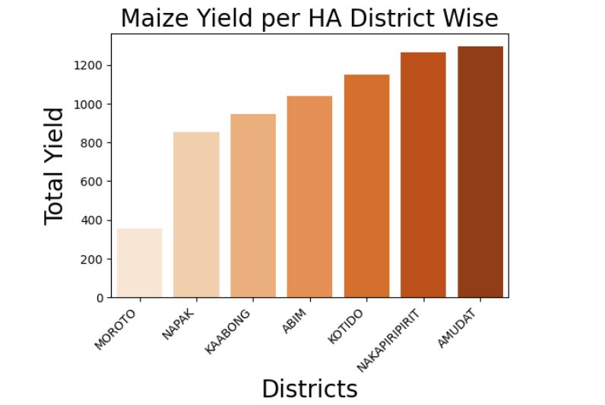

Slide 13
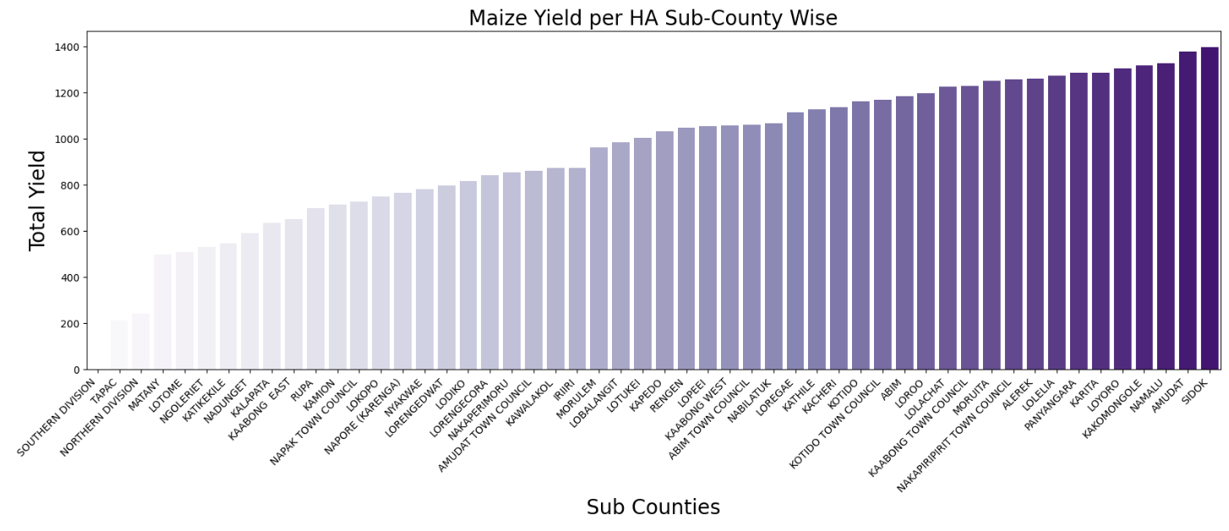

Slide 14
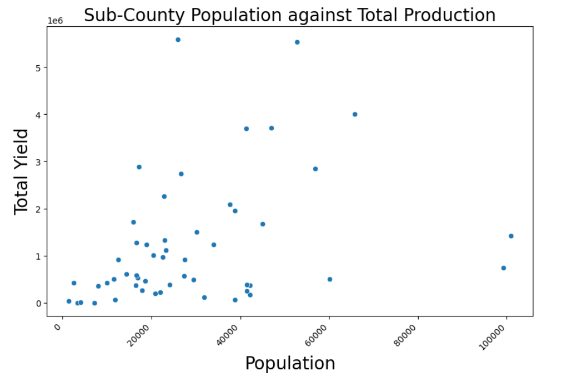
CORRELATION BETWEEN POPULATION SIZE AND YIELD
There is a weak but positive correlation between population size and total yield, suggesting that as the population increases, total yield tends to increase as well.

Slide 15
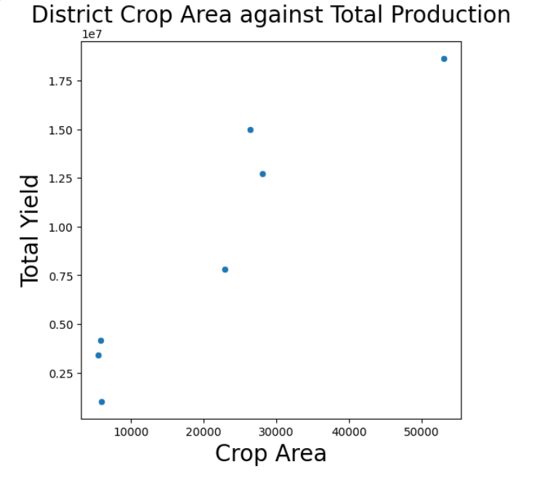
CORRELATION BETWEEN CROP AREA AND YIELD
The more area a region has allocated for crops, the higher the chance of a bigger yield.

Slide 16
CONCLUSION
If the organization has limited resources, focus should be made on the most affected areas first before proceeding to the other areas in the region.

Slide 17
RECOMMENDATIONS
As the region also suffers from pests and disease outbreaks, it would be important to explore the effect of these on crop production in the different regions as well.
It is also important to analyze the impact of farming practices used across the different regions on crop yields.
Population is a huge factor in farming. It is worth exploring how population density and not just the absolute numbers affect productivity.

Slide 18
APPENDIX
Links for a more detailed view of the work done
https://github.com/IdahAtieno/Group-2-Work/blob/main/Karamoja.ipynb
https://public.tableau.com/app/profile/idah.atieno6136/viz/Karamoja_17564939843160/Karamoja2017

Slide 19
THANK YOU

